Slide 1
FHA August
Architecture Council
August 10, 2017

Slide 2
Agenda-at-a-Glance
TIME | DESCRIPTION
10:05 AM | Welcome, Introductions
10:10 AM | Harmonizing NIEM to Clinical Health Standards
10:30 AM | CONNECT - Prescription Drug Monitoring Program (PDMP) Activities
10:50 AM | FHIM Current Status and Transition Planning
11:10 AM | Management of Gender Data and Security Architecture activities
11:40 AM | Round Table Updates/Discussion
11:55 AM

Slide 3
Introductions
New team member
Marco Demartin
Marco.demartin@hhs.gov
Alberto will support the NIEM effort

Slide 4
INFORMATIONAL: Harmonizing NIEM to clinical healthcare standards
Cait Ryan, Project Manager
Alberto S. Llanes, PhD, Lead Architect

Slide 5
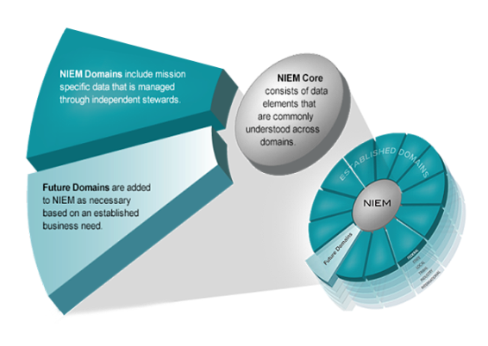
FHA’s Role in NIEM
FHA became steward for the NIEM Health Domain in 2013
ONC was previous steward
Little development; no resources
Unlike other domains, health does not have an immediate business need for NIEM.
  HL7 v2, C-CDA, FHIR, FHIM
  SNOMED, RxNorm, LOINC, NCPDP, ICD-10
Picture taken from niem.gov

Slide 6
NIEM: Why it matters
Designed to solve an over-arching business need: Interoperability
Several FHA partner agencies and organizations use NIEM including:
  DoD (a DoD CIO “NIEM First” approach & MilOps Domain)
  HHS ACF (a Human Services Domain)
Leveraged throughout federal and state law enforcement, intelligence, and public safety with agency supported domains including:
  Chemical, Biological, Radiological and Nuclear (CBRN)
  Infrastructure Protection
  Intelligence
  Justice
  Maritime
Clear communications among organizations and externally
  Need to use same code sets to so that the information exchanged is accurate

Slide 7
Through the Years: Partner’s Using NIEM
2014-SSA The CMS Federal Hub that authenticates individuals for the Health Marketplace subsidy and Medicaid eligibility uses NIEM to establish exchange between the States, CMS, IRS, SSA, & DHS
2015-ONC Roadmap- It is impossible for a single standard to support all the needs of a learning health system. Initiatives such as NIEM should be explored as tools that may support cross-domain interoperability”
2013- DoD CIO- In order to comply with White House guidance on the adoption of reference information exchanges, DoD will adopt NIEM as the best suited option for standards-based data exchanges
Oct. 2010- HHS joins DOJ and DHS becoming the third primary federal sponsor of the NIEM program
2005- In response to 9/11, DoJ and DHA Develop the NIEM to enable interoperability on disparate systems
2013
FHA becomes the
NIEM Health Domain
Steward

Slide 8
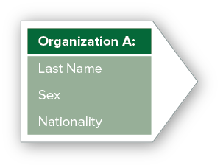

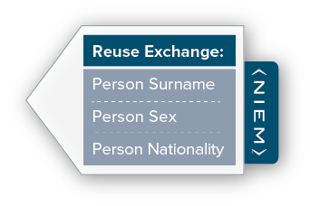

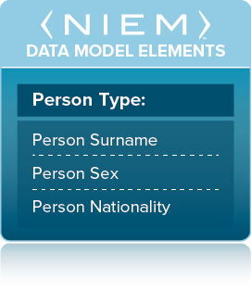



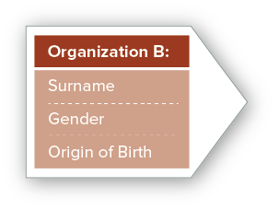
Model Overview
NIEM is not a system or database; it does not specify how to transmit or store data
NIEM is a standard way of defining the contents of messages being exchanged
  NIEM core includes data elements commonly understood across all NIEM domains, such as person, activity, location, and item.
  NIEM domains contain mission-specific data components that build upon NIEM core concepts.
Slide taken from niem.gov

Slide 9
NIEM Harmonization To Health Standards Overview
Purpose
  Better position federal, state, and local agencies to use the standards to interoperate with a greater degree of precision and consistency. Formalize the relationship between the NIEM health domain and the standards in FHIM; develop the NIEM health domain where necessary to accommodate the value sets and codes in Consolidated- Clinical Document Architecture (C-CDA) and FHIR.
Goals and Objectives
  Create and publish online resources that enables health information exchange among the NIEM domains.
Deliverables
  Lead the NIEM Health Domain Work Group, coordinating with other domains to identify and formalize UC requiring NIEM health domain elements.
  Create a NIEM Health Domain UML model
  Active participation and contribution to the NIEM Business Architecture Committee (NBAC) and NIEM Technical Architecture Committee (NTAC) discussions.
  Participation in the annual NIEM Face-2-Face in Arlington, VA.
Timeline
Efforts begin July 2017, duration TBD
Resources
  FHA Sr. Technical Expert (1 FTE)
  FHA Sr. Consultant (.35 FTE)
Challenges
  Tutorials will require periodic updates after the period of performance.
Notes:
Need agencies to confirm/ID SMEs and send to Caitlin

Slide 10
A Practical Solution
Create online tutorials that enable other domains to exchange clinical health information as needed through education and support
Educate the NIEM Community on how to best access clinical health elements, value sets, and codes
Health IT Community aren’t adopting NIEM as entrenched in HL7 standards and terminologies such as SNOMED-CT, RxNorm, and LOINC
NIEM is well established in non-clinical areas and will not adopt HL7 standards
Replicating the entirety of the FHIM and VSAC terminologies into NIEM is unsustainable
Support and develop IEPD for common Use Cases
Develop documentation that resides on NIEM.gov
This approach satisfies all of FHA’s responsibilities established in the Domain Steward Agreement (SDA) in an efficient manner
Notes:
Talk about how we came to this approach

Slide 11
Update: CONNECT - PDMP
Jason Smith, CONNECT Development Manager

Slide 12
Prescription Drug Pilot
Presented Prescription Drug Monitoring Program (PDMP) pilot as part of current scope to CONNECT CCB
3 MAY Managing Board Meeting – Approved to move forward from pilot to production ready
Request: Need agency contacts to establish PDMP requirements team
  Team to elicit agency use case and integration needs
  Team to advise on acceptable message standards, security framework, and client processing

Slide 13
UPDATE: FHIM Current Status and Transition Planning
Steve Wagner, FHA
Galen Mulrooney, FHA

Slide 14
Bottom Line Up Front
FHIM is focusing on:
Harmonization with other initiatives (CIMI, SOLOR, CQI, FHIR, etc.) by co-leading and participating in the HL7 IIM&T initiative
Achieving semantic interoperability in order to achieve full health information interoperability
Pilot testing to “make it real”
Transition planning
Notes:
Ok to have this in bullets
expand VSAC’s capacity to accommodate FHIR® operations and interactions on code systems and the associated value sets
better position federal agencies who use the standards to interoperate with a greater degree of precision and consistency
support conformance testing and enumeration of value set content for a multitude of federal programs and value sets defined by the FHIM

Slide 15
FHIM/CIMI Harmonization
FHIM has undertaken a major re-factoring to harmonize with CIMI. This has taken place in three phases:
Change the Clinical Information/Provenance structure from which all clinical models inherit to reflect the CIMI Clinical Statement model
Change all clinical classes to utilize the inherited provenance/“attribution”
Change all clinical classes to use the CIMI “Topic/Context” pattern, which separates the clinical meaning of the concept being modeled from the context in which it is used
Notes:
Ok to have this in bullets
expand VSAC’s capacity to accommodate FHIR® operations and interactions on code systems and the associated value sets
better position federal agencies who use the standards to interoperate with a greater degree of precision and consistency
support conformance testing and enumeration of value set content for a multitude of federal programs and value sets defined by the FHIM

Slide 16
FHIM/CIMI Harmonization
Phase 1 and 2 are complete
Phase 3 will be completed in September
Further minor refinement is likely as we harmonize FHIM and the CIMI Reference Model as closely as possible
The new CIMI patterns make the FHIM binding to terminology more straightforward
We are testing the FHIM/CIMI alignment by comparing the FHIM structures to the corresponding CIMI structures across several information domains
Notes:
Ok to have this in bullets
expand VSAC’s capacity to accommodate FHIR® operations and interactions on code systems and the associated value sets
better position federal agencies who use the standards to interoperate with a greater degree of precision and consistency
support conformance testing and enumeration of value set content for a multitude of federal programs and value sets defined by the FHIM

Slide 17
FHIM/CIMI Harmonization
Working on the tooling necessary to generate the CIMI reference model from the FHIM.
  This involves conversion from UML to a CIMI notation called Basic Meta-Model (BMM) and some transformation of structures
  CIMI will then constrain the BMM
There is an open question concerning whether and how the resulting CIMI “Detailed Clinical Models” (DCMs) are to be imported back into the FHIM
Further consensus is needed on whether and how existing FHIM - FHIR tooling would be used to generate FHIR Profiles for CIMI
  Two options: FHIR Profiles generated from FHIM or FHIR Profiles generated from CIMI (which will require new CIMI tools)
Notes:
Ok to have this in bullets
expand VSAC’s capacity to accommodate FHIR® operations and interactions on code systems and the associated value sets
better position federal agencies who use the standards to interoperate with a greater degree of precision and consistency
support conformance testing and enumeration of value set content for a multitude of federal programs and value sets defined by the FHIM

Slide 18
FHIM/SOLOR Harmonization
CIMI will assert SOLOR terminology bindings
FHIM will leverage references to the following existing supported formalisms and their respective bindings (descending order of maturity):
          VSAC for C-CDA
          FHIR for FHIR
          SOLOR for CIMI
          Others

Slide 19
FHIM/SOLOR Harmonization
SOLOR is preparing an October release
          Representing SNOMED CT, LOINC, RxNorm
          Asserting relationships among existing values
    This release will also support initial CIMI values for:
          Skin & Wound model
            Question bindings (LOINC)
            Answer values (SNOMED CT concepts) and SNOMED CT value sets

Slide 20
FHIM Support for FHIR Activities
The FHIM information model is being aligned with and mapped to FHIR STU 3
As of June 30th, we have aligned and mapped 442 concepts to the FHIM in 32 out of the 95 non-infrastructure FHIR Resources
We have included the FHIR definitions in the FHIM definitions
Completion of mapping all FHIR Resources is expected by September 30th

Slide 21
FHIM Tooling Support for FHIR Activities
FHIR DSTU2 Support
Able to generate FHIR Profiles from FHIM utilizing SIGG
FHIR Terminology
Updating FHIM methodology to leverage FHIR Uniform Resource Identifiers (URIs) and Terminology Services
FHIR STU3 Support
Extending Semantic Interoperability Guide Generator (SIGG) software to generate STU3 Profiles using the combination of FHIM and CIMI
    Generate FHIR profile based on FHIM/CIMI model for Nutrition Assessment
Generate FHIR Profile based on FHIM/CIMI representation of HL7 Skin Assessment Ballot

Slide 22
FHIM Transition Planning
Discussed transition planning options at FHIM Strategy meeting in June
Identified an initial list of 8 possible transition options
Currently analyzing and comparing options
Plan to identify top three options by end of CY 2017, choose best option by March 2018 and begin transition planning
Notes:
HHS/CIO
NLM
IPO, DoD DHA and/or VA
ONC
NIST standards & testing
Non-Government:
OpenGroup
HL7 (US RealmFHIR US Core, C-CDA)
OSEHRA-HSPC

Slide 23
Management of Gender Data and Security Architecture
Open Discussion

Slide 24
Management of Gender Data
How is your agency handling gender related data?
Was the Gender Data question already discussed (within or outside the health domain)?
Is anyone aware of current work being performed in this area?
What role should the federal government have on this topic? What should it be part of (NIEM/FHIM)?
One possible approach:
Gender (DNA)
  Male
  Female
  Unknown
  Other
  Ambiguous
Administrative
  Male
  Female
  Unknown
  Other
  Ambiguous
Identified
  Male
  Female
  Unknown
  Other
  Ambiguous

Slide 25
Security Architecture
FHA will support HHS on HCCIC
Health Cybersecurity and Communications Integration Center (HCCIC): a centralized hub for monitoring cyberthreats to the healthcare sector and to share information with the private sector
Healthcare-focused cousin to the DHS’ National Cybersecurity and Communications Integration Center (NCCIC)
To get the work done most efficiently, whom within your agency should we work with?
What health related security architecture is your agency working on?

Slide 26
THANKS FOR
COMING
See you in September

Slide 27
Backup Slides
Backup Slides for the August 2017 Managing Board Meeting
August 03, 2017

